Slide 1
Our Impact in the Evolving Data Landscape
Dionne L Price, PhD
Deputy Director, Office of Biostatistics

Slide 2
Disclaimer
This presentation reflects the views of the author and should not be construed to represent FDA’s views or policies.

Slide 3
Outline
The Evolving Landscape
FDA Organizational Structure
Challenges and Opportunities
Evolution of R

Slide 4
The Evolving Landscape

Slide 5
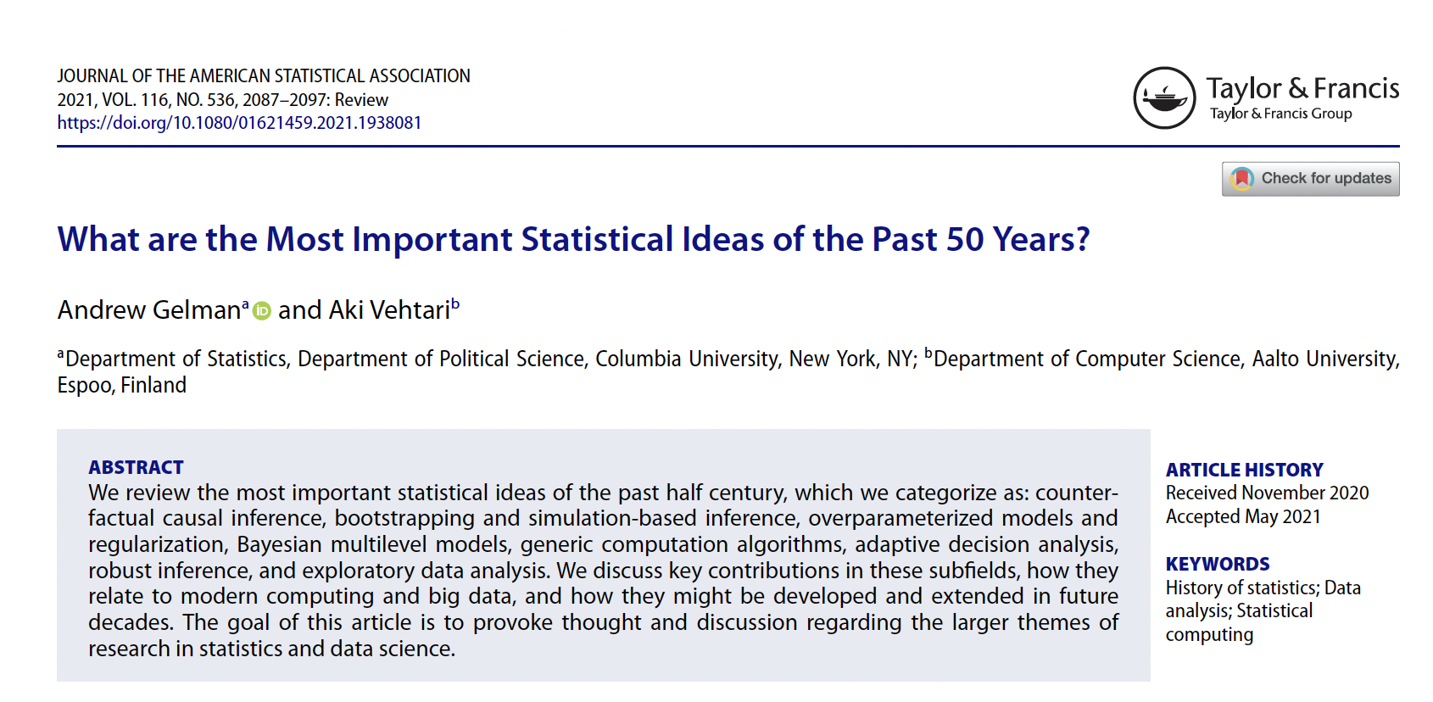
Evolving Scientific Thinking
Bootstrapping and Simulation-Based Inference
Over-parameterized
Models and Regularization
Counterfactual Causal Inference
Bayesian Multilevel Models
Generic Computation Algorithms
Robust Inference
Exploratory Data Analysis
Adaptive Decision Analysis

Slide 6


Evolving Data Sources

Slide 7
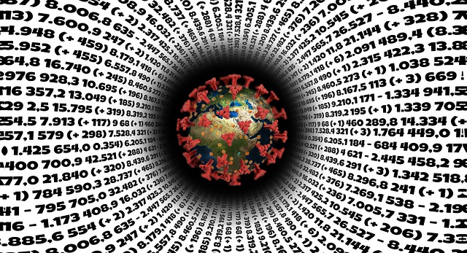
COVID-19

Slide 8

Climate Change

Slide 9


Machine Learning
https://www.nytimes.com/2022/12/22/nyregion/madison-square-garden-facial-recognition.html

Slide 10
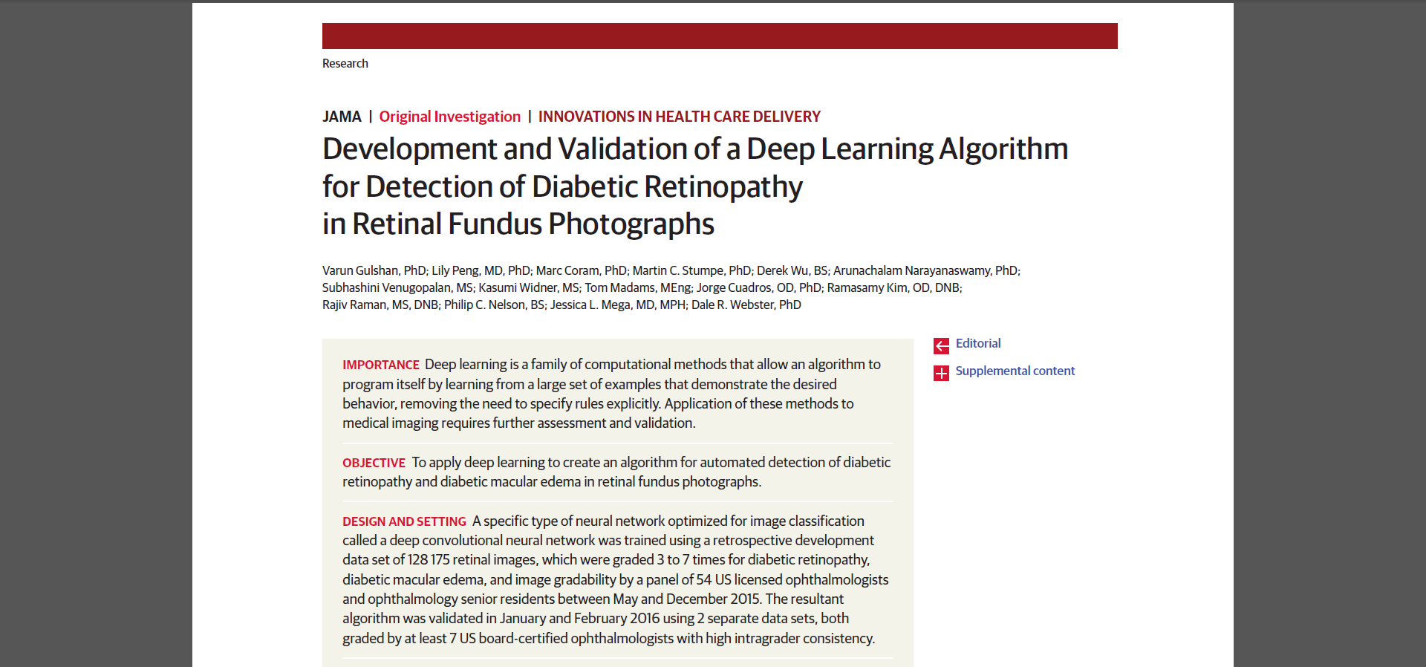
Artificial Intelligence: Healthcare

Slide 11
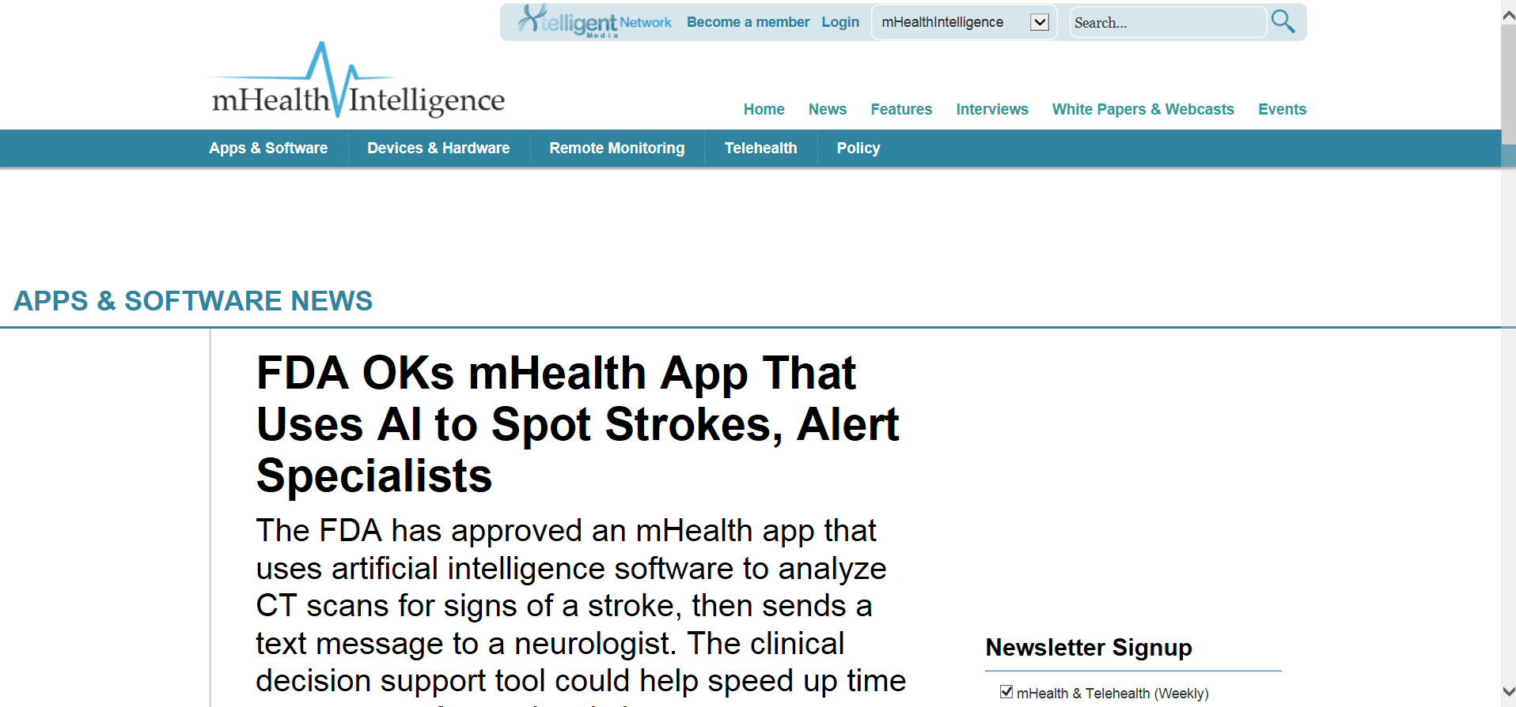
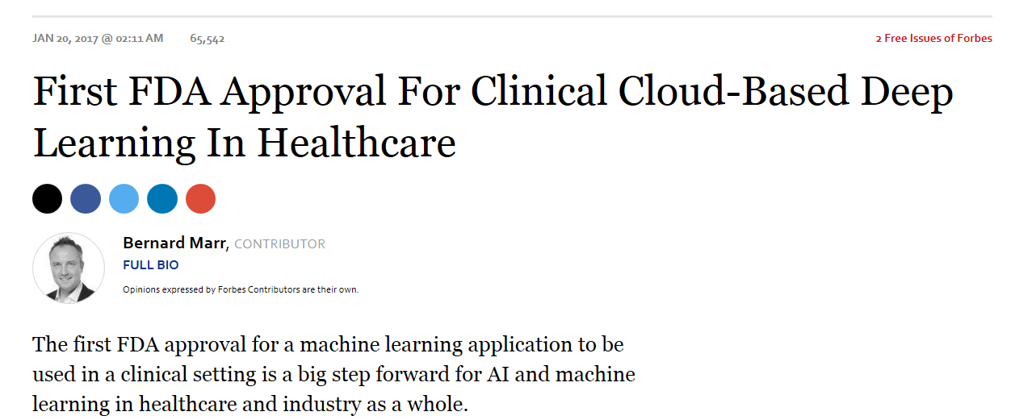
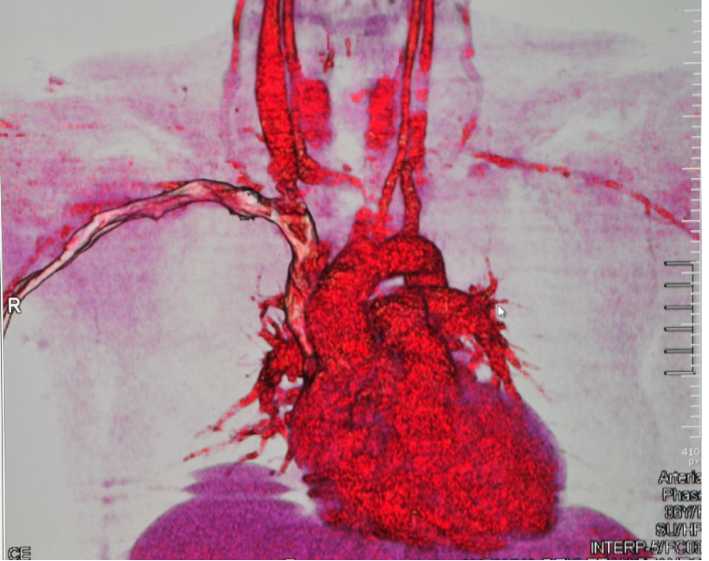
Artificial Intelligence: FDA

Slide 12
FDA Organizational Structure

Slide 13

FDA Organization
Office of the Chief Counsel
Office of the Commissioner
Commissioner of Food & Drugs
Principal Deputy Commissioner
Chief of Staff
Chief Medical Officer
Office of the Counselor to the Commissioner
Office of the Executive Secretariat
Office of
Digital Transformation
Center for Biologics Evaluation & Research
Center for
Devices &
Radiological Health
Center for
Drug Evaluation & Research
Center for
Food Safety &
Applied Nutrition
Center for
Tobacco Products
Center for
Veterinary Medicine
Oncology Center of Excellence
Office of Regulatory Affairs
Office of Clinical Policy & Programs
Office of External Affairs
Office of Food Policy & Response
Office of Minority Health &
Health Equity
Office of Operations
Office of Policy,
Legislation, &
International Affairs
Office of the Chief Scientist National Center for Toxicological Research
Office of Women’s Health
Source: www.fda.gov/about-fda/fda-organization-charts/fda-overview-organization-chart

Slide 14
CDER Organization (simplified)
CDER
New Drugs
Surveillance & Epidemiology
Translational Sciences
Biostatistics
Generic Drugs
Computational Science
Study Integrity & Surveillance
Clinical Pharmacology

Slide 15
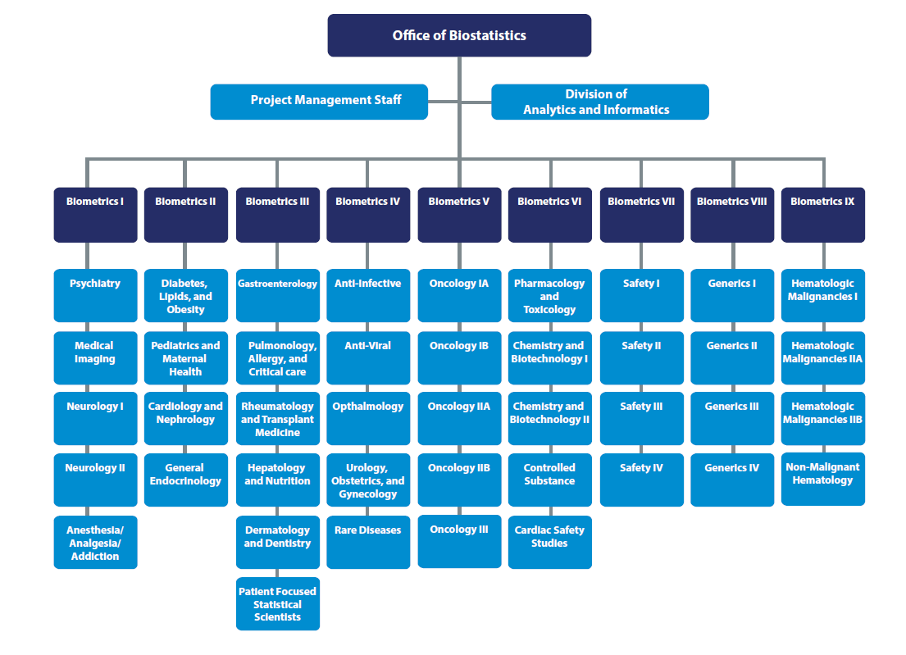

Slide 16

Office of Biostatistics Mission
Provide CDER and other internal and external stakeholders with statistical leadership, expertise, and advice to foster the expeditious development of safe and effective drugs and therapeutic biologics for the American people. Protect the public health by applying statistical approaches for monitoring the effectiveness and safety of marketed drugs and therapeutic biologic products.

Slide 17
Challenges and Opportunities

Slide 18
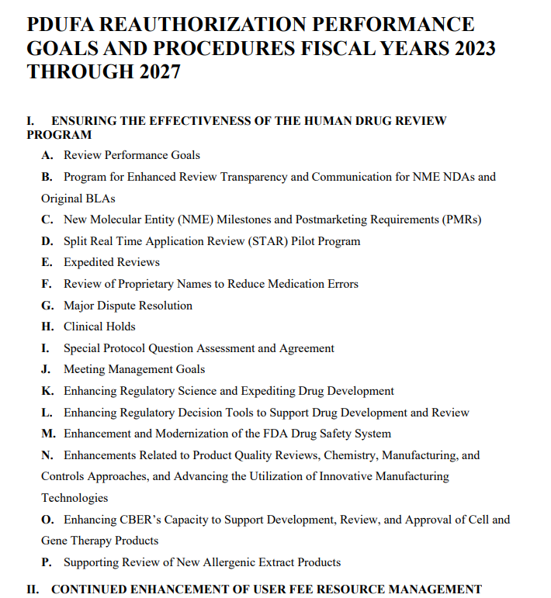
Prescription Drug User Fee Act (PDUFA VII)
This document contains the performance goals and procedures for the Prescription Drug User Fee Act (PDUFA) reauthorization for fiscal years (FYs) 2023-2027, known as PDUFA VII. It is commonly referred to as the “goals letter” or “commitment letter.” The goals letter represents the product of FDA’s discussions with the regulated industry and public stakeholders, as mandated by Congress. The performance and procedural goals and other commitments specified in this letter apply to aspects of the human drug review program that are important for facilitating timely access to safe, effective, and innovative new medicines for patients……This will allow FDA and the regulated industry to identify emerging challenges and develop strategies to address these challenges to ensure the efficiency and effectiveness of the human drug review program.

Slide 19
Prescription Drug User Fee Act (PDUFA VII)
Rare Diseases
Real World Evidence
Digital Health Technologies
Patient Focused Drug Development
Complex Innovative Trial Designs

Slide 20
Challenges in Rare Disease Drug Development
Natural history is often poorly understood
Diseases are progressive, serious, life-limiting and often lack adequate approved therapies
Small populations impact study design options
Phenotypic and genotypic heterogeneity within a disorder
Drug development tools - outcome measures and biomarkers often lacking
Lack of precedent, including clinically meaningful endpoints
Ethical considerations for children in clinical trials

Slide 21
Opportunities for Statistical Innovation
Incorporation of external information into trials in a Bayesian framework
Sources of external information include, but are not limited to, natural history studies, patient registries, early phase trials, etc.
Choice of priors
Decision criteria via posterior distributions
Small n Sequential Multiple Assignment Randomized Trial (snSMART)
Adaptive designs with multiple adaptations
n-of-1 designs
Randomized withdrawal designs
Platform trials
Analyses of multi-component endpoints

Slide 22

Vision
Speeding and increasing the development of effective and safe treatment options addressing the unmet needs of patients with rare diseases.
Mission
CDER’s ARC Program drives scientific and regulatory innovation and engagement to accelerate the availability of treatments for patients with rare diseases.

Slide 23
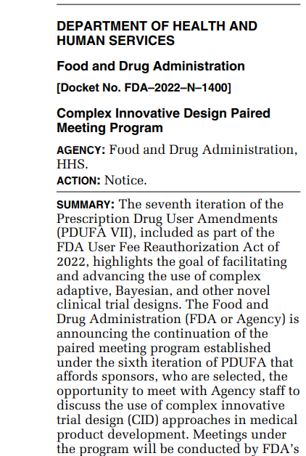
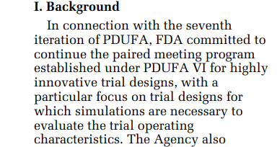

Complex Innovative Trial Designs (CIDs) Federal Register Notice

Slide 24
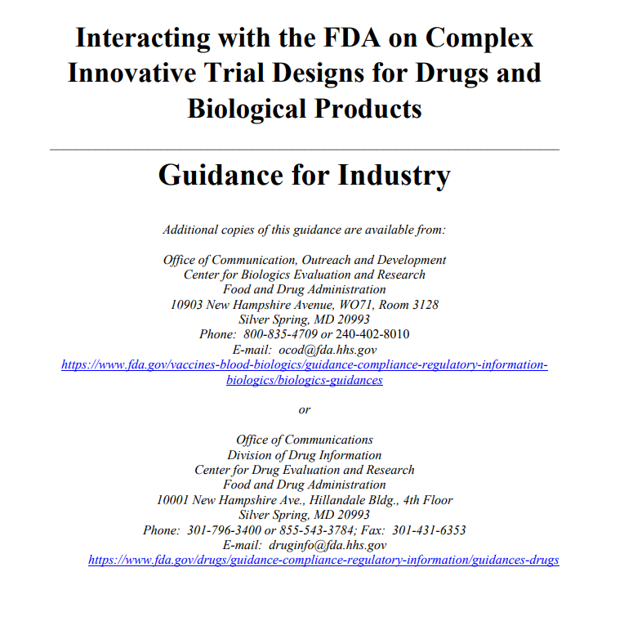
Complex Innovative Trial Designs
Although CID has been considered to refer to complex adaptive, Bayesian, and other novel clinical trial designs, there is no fixed definition of CID because what is considered innovative or novel can change over time. For the purposes of this guidance, CID includes trial designs that have rarely or never been used to date to provide substantial evidence of effectiveness in new drug applications or biologics license applications. CID can also include the novel application of complex trial design features to a given indication even when those design features have been used in other indications

Slide 25
Complex Innovative Designs Paired Meeting Program
Joint effort of the Center for Drug Evaluation and Research and Center for Biologic Evaluation and Research
Sponsors
submit designs
have the opportunity to engage with regulatory team on designs via two meetings
Agency
will select up to 2 submissions per quarter
uses the design as a case study for continuing education and information sharing
Five-year duration
Notes:
Stress multidisciplinary team!!!
FY 2018-FY 2022

Slide 26
CID includes….
Complex Adaptive Designs (frequentist or Bayesian)
Seamless designs
For example, combining dose-finding and hypothesis confirmation in a trial
Adaptations to multiple design features such as treatment arm selection, patient allocation, or endpoint selection
Formal incorporation of “prior” information
Placebo augmentation using external controls or other data sources (e.g. real world data)
Leveraging or borrowing strength from information internal or external to the trial

Slide 27
CID includes….
Use of a posterior probability to determine trial success criteria
Master protocols (platform, umbrella, and basket designs)
Sequentially Multiple Assignment Randomized Trial (SMART) designs

Slide 28
Evolving Landscape (pre-PDUFA VI)
Limited use of CIDs to provide substantial evidence of effectiveness across a broad range of therapeutic areas
Lack of clarity around regulatory acceptance and guidance
Lack of experience and understanding
FDA inability to publicly discuss CID proposals under Investigational New Drugs
Realization of the promise of CIDs

Slide 29
Digital Health Technology
A system that uses computing platforms, connectivity, software, and sensors for healthcare and related uses. These technologies span a wide range of uses, from applications in general wellness to applications as a medical device. They include technologies intended for use as a medical product, in a medical product, or as an adjunct to other medical products (devices, drugs, and biologics). They may also be used to develop or study medical products.
Definition from FDA-NIH BEST Glossary.
Available at https://www.ncbi.nlm.nih.gov/books/NBK338448

Slide 30
Examples of DHTs
Wearable, implantable, or ingestible sensors
Accelerometers, continuous glucose monitors, heart rate monitors
Software applications
Apps that collect clinical outcome assessments (COAs)
Other general-purpose hardware
Mobile phone camera

Slide 31
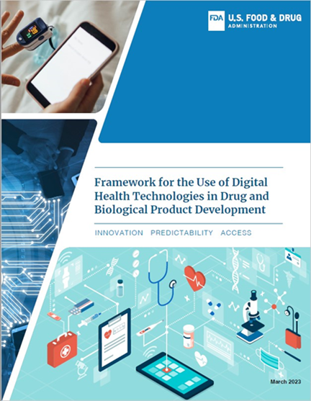
PDUFA VII and DHT
IV. C. Enhancing Use of DHT to Support Drug Development and Review
C.1 Develop DHT Framework
C.2 Establish DHT Steering Committee
C.3 Convene 5 public meetings/workshops
C.4 Identify 3 demonstration projects
C.5 Develop Guidance on use of DHTs in traditional and decentralized clinical trials
C.6 Develop Prescription Drug Use-Related Software (PDURS) Guidance
C.7 Expand review capacity and expertise
C.8 Enhance IT capabilities to support the review of DHT-generated data

Slide 32
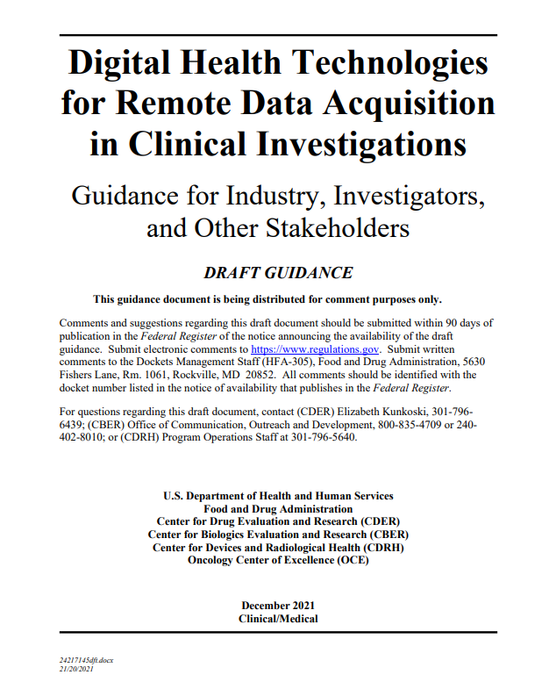
Draft Guidance on Digital Health Technologies
This draft guidance provides recommendations to facilitate the use of DHTs in clinical investigations
Selection, verification & validation
Use of DHT to collect data for trial endpoints
Identification and management of risk
Helps accelerate efficient medical product development

Slide 33
Opportunities to Advance Innovation
CID Paired Meeting Program
Guidance
Workshop
Model Informed Drug Development Paired Meeting Program
Accelerating Rare Disease Cures
Rare Disease Endpoint Advancement Pilot
Advancing Real World Evidence Pilot
Enhancing Use of Digital Health Technologies

Slide 34
The Evolution of R

Slide 35
Evolving Landscape
Data Evolution
R
SAS

Slide 36
Statistical Software Clarifying Statement
FDA does not require use of any specific software for statistical analyses, and statistical software is not explicitly discussed in Title 21 of the Code of Federal Regulations [e.g., in 21CFR part 11]. However, the software package(s) used for statistical analyses should be fully documented in the submission, including version and build identification.
As noted in the FDA guidance, E9 Statistical Principles for Clinical Trials (available at http://www.fda.gov/Drugs/GuidanceComplianceRegulatoryInformation/Guidances/default.htm), “The computer software used for data management and statistical analysis should be reliable, and documentation of appropriate software testing procedures should be available.” Sponsors are encouraged to consult with FDA review teams and especially with FDA statisticians regarding the choice and suitability of statistical software packages at an early stage in the product development process.
Issued by FDA May 6, 2015

Slide 37
R-based test submission – Pilot 1
“The R Consortium is happy to announce that on Nov 22nd, 2021, the R Submissions Working Group successfully submitted an R-based test submission package through the FDA eCTD gateway! The submission package has been received by the FDA staff who were able to reproduce the numerical results.
All submission materials can be found at: https://github.com/RConsortium/submissions-pilot1-to-fda
The pilot 1 test submission, was an example submission package following eCTD specifications which include a proprietary R package, R scripts for analysis, R-based analysis data reviewer guide, and other required eCTD components. To our knowledge, this is the first publicly available R-based FDA submission package. We hope this submission package and our learnings can serve as a good reference for future R-based regulatory submissions from different sponsors. Additional agency feedback will be shared in future communications.”
https://www.r-consortium.org/blog/2021/12/08/successful-r-based-test-package-submitted-to-fda

Slide 38
R Submission Pilot 2
Pilot 2 - shiny submission
Goal: Example R based submission contains a shiny app, submission through the current FDA e-submission system and process
Key evaluation aspects:
For Submitter
Submission of an shiny app through the eCTD portal
The shiny codes will be provided as a proprietary R package
For FDA Reviewer
Reproduce analysis results by deploying the shiny app on a FDA laptop/server
R Submissions Working Group - R Submission Pilot 2 (rconsortium.github.io)

Slide 39
Summary
With the changing scientific and data landscape, challenges and opportunities prevail. There will be an increased need for computing and graphical capabilities.

Slide 40
Acknowledgements
Dr. Matilde Kam
Colleagues in the Office of Biostatistics

